Slide 1


PROJECT PRESENTATION:
Motorino
best new Toronto location
https://github.com/b-tank1/proj1_gta_restaurant

Slide 2
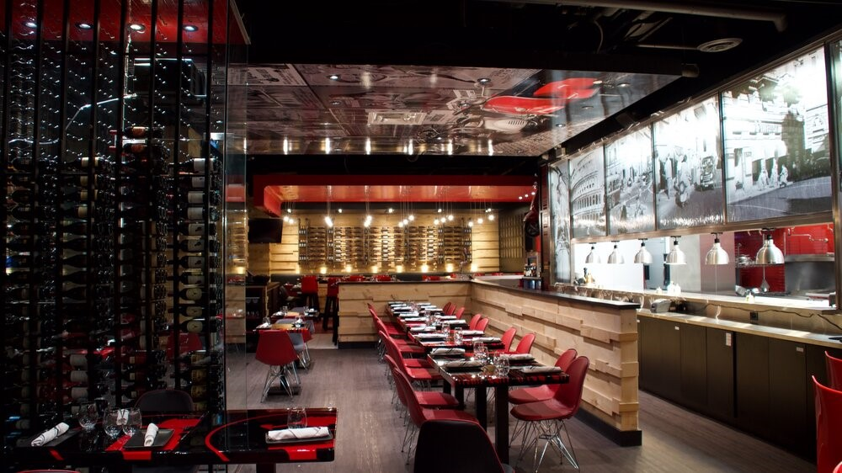
Executive Summary
Goals and objectives.
Problem statement
In recent years, the restaurant industry has faced unprecedented challenges that have never been experienced. Now, more than ever before, data sets need to be analyzed, reviewed and scrutinized to give an entrepreneur the most optimal chance of success.
Our stated project goals are as follows:
Analyze data sets from all neighborhoods in the GTA – income, population density, ethnicity & crime rates
Examine average real-estate leasing prices across our chosen area - for our cost base
Graph analyzed data to interpret comparisons between neighborhoods
Check 3rd party customer ratings of competing restaurants in the area. This will help us determine the density and strength of our competition
Project future restaurant sales, we will do this by implementing historical sales data for similar categorical restaurants

Slide 3
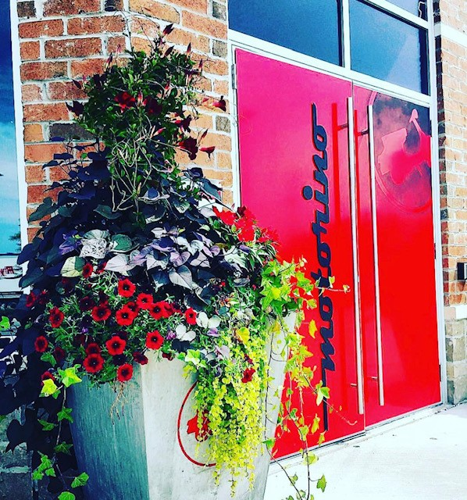
About Motorino.
Motorino is an modern Italian eatery, where we responsibly source all ingredients and carefully incorporate the best flavors into each and every dish!
The “Italian Modern” experience
At Motorino we offer responsibly sourced fresh ingredients with a modern twist – while paying tribute to the Italian and European heritage
The best of the best!
Every dish we create is made from Scratch. The only food you will find in our freezers is our world-famous Gelato
It’s not Italy, but it’ll do
If you close your eyes, the traditional smells and the sounds of friends and family will take you back to the old country. Almost every product we source comes directly from Italy.

Slide 4


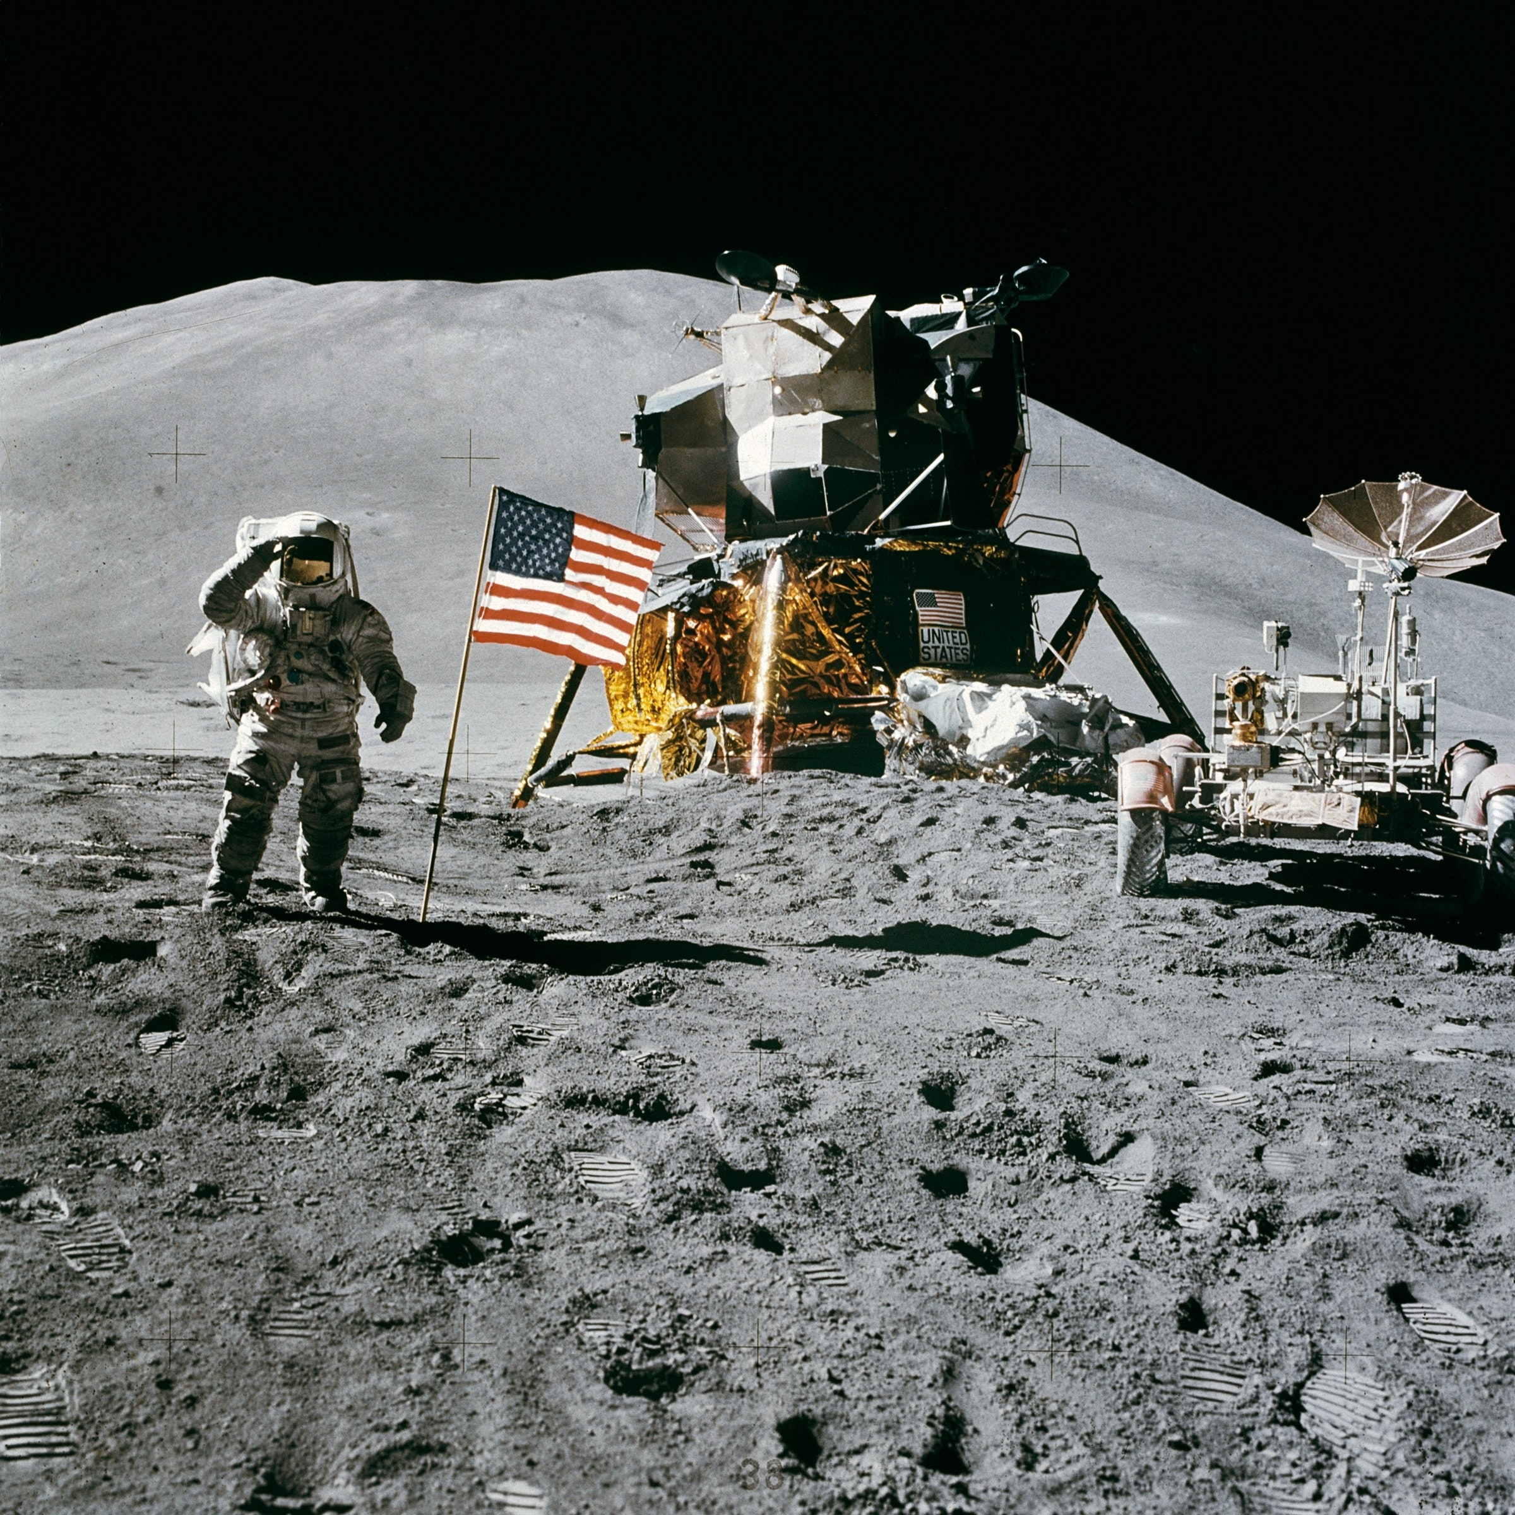
Data Collection, Clean-up and Exploration process.
From median neighbourhood real estate pricing to crime rate data collection, multiple factors were considered, integrated and investigated
Data Collection/Scrapping
Data Clean up
Exploration
Searching multiple sites and offered data services to get as much relevant data as possible. Collection of neighborhood income, crime rates, lease costs, disposable income etc..
After collecting thousand of data points, to get the most accurate concluding data our group had to review and keep relevant data while discarding irrelevant data
Deep exploration across multiple data sources, API’s and websites was required to get the correct information required for our concluding answer.

Slide 5
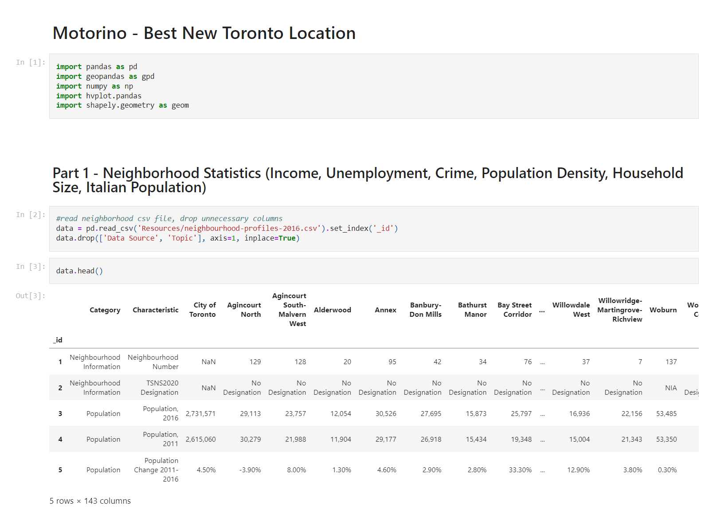

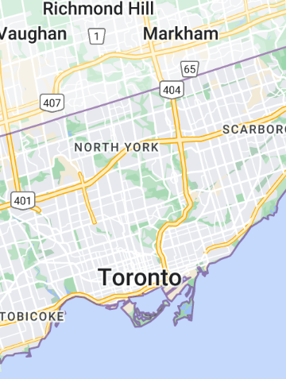
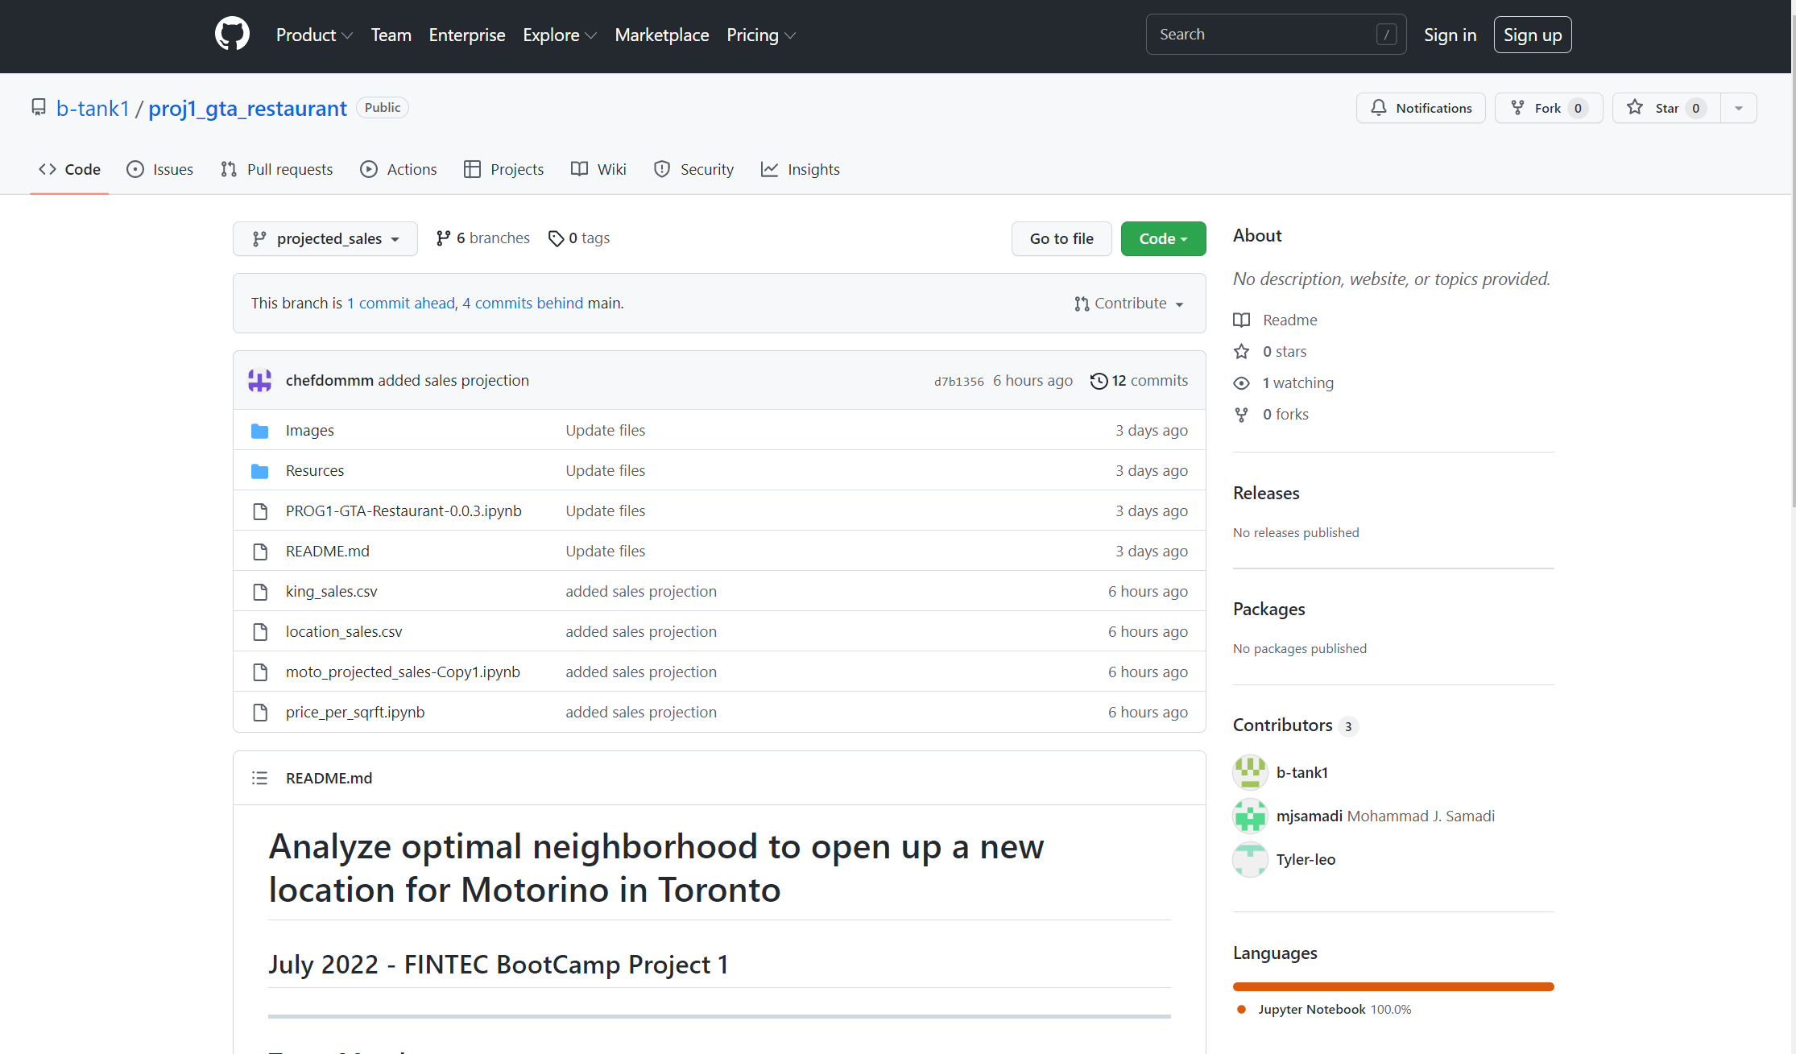
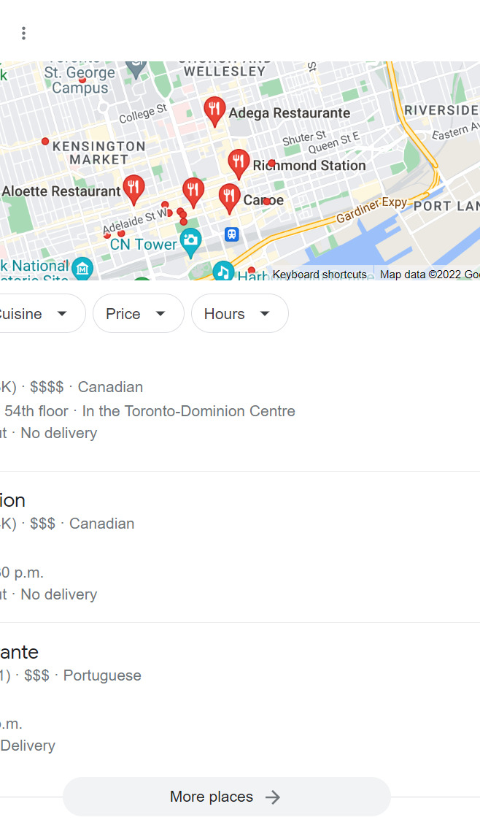
Where did you get all that data…
Our data sources came from multiple, trusted open and private data sources
Our Data sources:
Toronto Open Source, multiple available data sets for:
Neighborhood Income
Neighborhood ethnicity
Neighborhood Crime data
FourSquare Place API
Breakdown of how many restaurants in the area’s
Longitude and Latitude of each restaurant
Motroino sales projection, CSV historical data provided by owner from POS system.
Google maps extractor (verified FourSquare)
Web Harvey – scrapping tool
Kaggle – Data from previous investigations into Toronto neighborhoods
Further CMHC data for average and median household income

Slide 6
Approach to achieving our goals.
If you use this site regularly the great business and would like to the best design professional help keep the site on the Internet.
And the winner is!!!
After extensive data analysis and group discussion, we will pick the best neighborhood based on results. Stay tuned!
Python Coding and analysis of resulting data and graphs
Adjudicate final group decision
Running our data collection, and analyzing the resulting data from this powerful tool will give us a massive competitive advantage for our final business decision
Python coding and analysis of graphs & data results
Integration of Foursquare API
FourSquare helped us analyze our competition and how many there are
Integration of API
Data Mining
Correlating, dividing data sets to analyze as a team. Th
Data mining

Slide 7

Enough talk run the code.
Let’s run the code and let it do the talking!!! Based on the results lets see what the best neighborhood in the GTA is for our modern Italian restaurant.

Slide 8
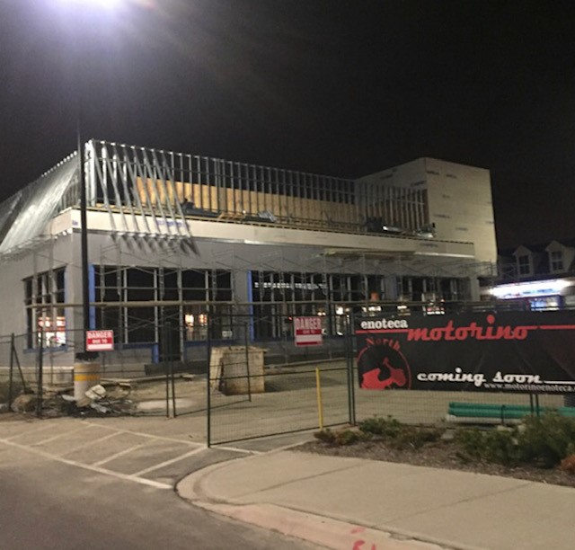

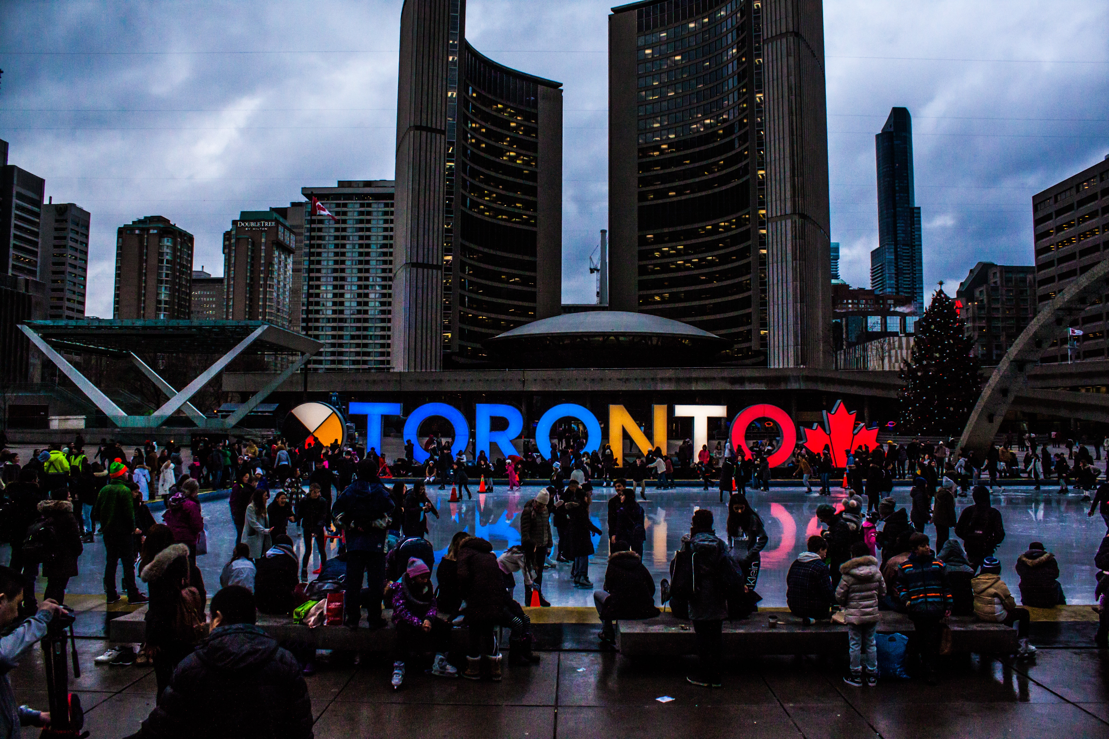
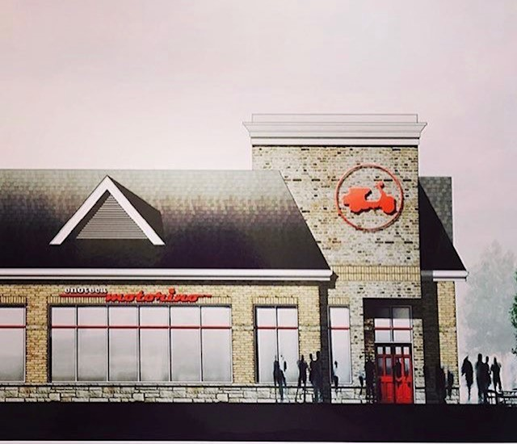
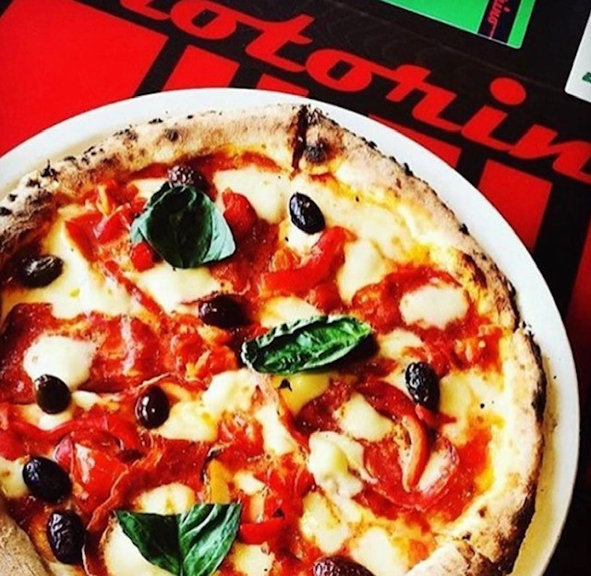

And the winner is!!!!
Etobicoke
After extensive data analysis, neighbourhood comparisons and financial consideration – our final decision to open up our new restaurant is in the neighbourhood of Etobicoke .
Neighbourhood comparisons
During our analysis, Etobicoke was weighted at or near the top of all our parameters!
Competitive Advantage
There is a low number of competitors in the area, and our Modern Italian cuisine is unique to the area
Extensive Growth opportunity
High disposable income, competitive leasing rates, and low crime rates makes Etobicoke a destination posed for future growth

Slide 9

What we learned
If we only had more time…
What we learned… questions and future exploration
We learned the power of fintech tools! Python and API’s (FourSquare), can give us an significant competitive analyses
Risk is considerably reduced with proper planning and data analysis
The source of the Data matters – accuracy was extremely important to come to the correct conclusion
Demographics matter – disposal income, size of family, age of average citizens, and crime rate play a huge role in final decisions
Data can be overwhelming! Narrowing down our data sets is time consuming but extremely important for accuracy
We would have found more data sets for restaurant sales, we had historical data for our own and publicly traded companies
At first we were overwhelmed by the amount of data, With more time we could have narrowed our search further.
The Census data we had was dated 2016, 2021 data is expected to come out shortly. We could have waited for more accurate up to date data. More accurate conclusion.
With more time we could have found more lease listing , and compiled a more accurate data frame

Slide 10
END.

